Slide 1

Styling the Web: A Beginner's Guide to CSS
Welcome to this exciting journey into the world of Cascading Style Sheets (CSS)! In this presentation, we will uncover the fundamental concepts of CSS, enabling you to transform plain HTML into visually stunning and engaging web pages. Get ready to unleash your creativity and bring your web designs to life!

Slide 2
What is CSS?
CSS, or Cascading Style Sheets, is a powerful stylesheet language used for describing the presentation of a document written in HTML. Think of it as the "makeup" for your website, dictating how elements are displayed on screen, paper, or in other media. It's what makes your website look good, from the colours and fonts to the layout and responsiveness.
Why we use CSS
HTML vs. CSS
CSS separates content from presentation, making your code cleaner and more efficient. It allows for consistent styling across multiple web pages and enables responsive design for various devices.
HTML provides the structure and content of a webpage (like the bones of a body), while CSS controls the visual appearance and layout (the skin, hair, and clothes).

Slide 3

Adding CSS to HTML
There are three primary ways to incorporate CSS into your HTML documents, each with its own advantages depending on the scope of your styling needs.
Inline Styles
Internal Styles
External Styles
Applied directly to individual HTML elements using the style attribute. Best for unique styling of single elements, but can make HTML cluttered.
Defined within a <style> tag in the <head> section of your HTML document. Ideal for styling a single page.
Linked from an external .css file, usually in the <head> section. This is the most recommended method for larger projects, promoting reusability and maintainability across multiple pages.
<head>
<style>
h1 { color: green; }
</style>
</head>
<h1 style="color: blue;">Hello World</h1>
<head>
<link rel="stylesheet" href="styles.css">
</head>
Specificity
Specificity is how browsers decide which CSS rule to apply if multiple rules target the same element. It's like a scoring system, where more specific rules (e.g., ID selectors) outweigh less specific ones (e.g., tag selectors).

Slide 4




Understanding CSS Syntax
At its core, CSS syntax is straightforward. Each style rule consists of a selector, a property, and a value. Mastering this structure is key to writing effective CSS.
Selector
Property
Value
Points to the HTML element you want to style (e.g., h1, p, .class-name).
The specific attribute of the HTML element you want to change (e.g., color, font-size, background).
The setting for the chosen property (e.g., blue, 16px, #F0F0F0).
Code Example:
selector { property: value; } /* Example: */ p { color: #333; font-size: 16px; }

Slide 5



CSS Selectors: Targeting Elements
Selectors are the foundation of CSS, allowing you to precisely target the HTML elements you wish to style. Different types of selectors offer varying levels of specificity and control.
Tag Selector
Class Selector
Targets all instances of a specific HTML tag. For example, p { color: grey; } will style all paragraph elements.
Targets elements with a specific class attribute. Indicated by a dot (.), e.g., .my-class { font-weight: bold; }. Classes can be applied to multiple elements.
ID Selector
:hover Selector
Targets a single element with a unique ID attribute. Indicated by a hash (#), e.g., #my-id { border: 1px solid black; }. IDs must be unique per page.
A pseudo-class selector that applies styles when a user's mouse cursor is over an element, e.g., button:hover { background-color: blue; }. Great for interactive effects.

Slide 6
Styling Text with CSS
CSS provides extensive properties for controlling every aspect of your text, from its size and weight to its alignment and transformation. Make your content readable and aesthetically pleasing.
font-size: Controls the size of the text (e.g., 16px, 1.2em).
text-align: Aligns text horizontally (e.g., left, center, right).
font-weight: Sets the thickness of characters (e.g., normal, bold, 700).
text-decoration: Adds or removes decorations like underlines (e.g., none, underline).
font-family: Specifies the typeface for the text (e.g., Arial, sans-serif).
text-transform: Changes the casing of text (e.g., uppercase, lowercase, capitalize).
Example:
p { font-family: 'Open Sans', sans-serif; font-size: 18px; font-weight: 400; text-align: center; text-decoration: none; text-transform: capitalize; }

Slide 7
Working with Colours in CSS
Colours are vital for visual appeal and brand identity. CSS offers several ways to define colours, giving you flexibility and control over your design palette.
Hexadecimal (Hex)
RGB
A six-digit alphanumeric code (e.g., #RRGGBB) representing red, green, and blue values. #FF0000 is red, #000000 is black.
Red, Green, Blue values from 0 to 255 (e.g., rgb(255, 0, 0) for red). Offers more intuitive control over colour mixing.
RGBA
Red, Green, Blue, Alpha. Similar to RGB but includes an alpha channel for opacity (e.g., rgba(255, 0, 0, 0.5) for 50% opaque red).

Slide 8

Enhancing with Backgrounds
Backgrounds add depth and visual interest to your web pages. CSS provides powerful properties to control background colours, images, and their behaviour.
background-color: Sets the solid colour of the background (e.g., lightgrey, #F0F8FF).
background-position: Controls the starting position of a background image (e.g., center top, 50% 50%).
background-image: Specifies an image to be used as the background (e.g., url('image.png')).
Example:
body { background-color: #F8F8F8; background-image: url('pattern.png'); background-position: top center; }

Slide 9
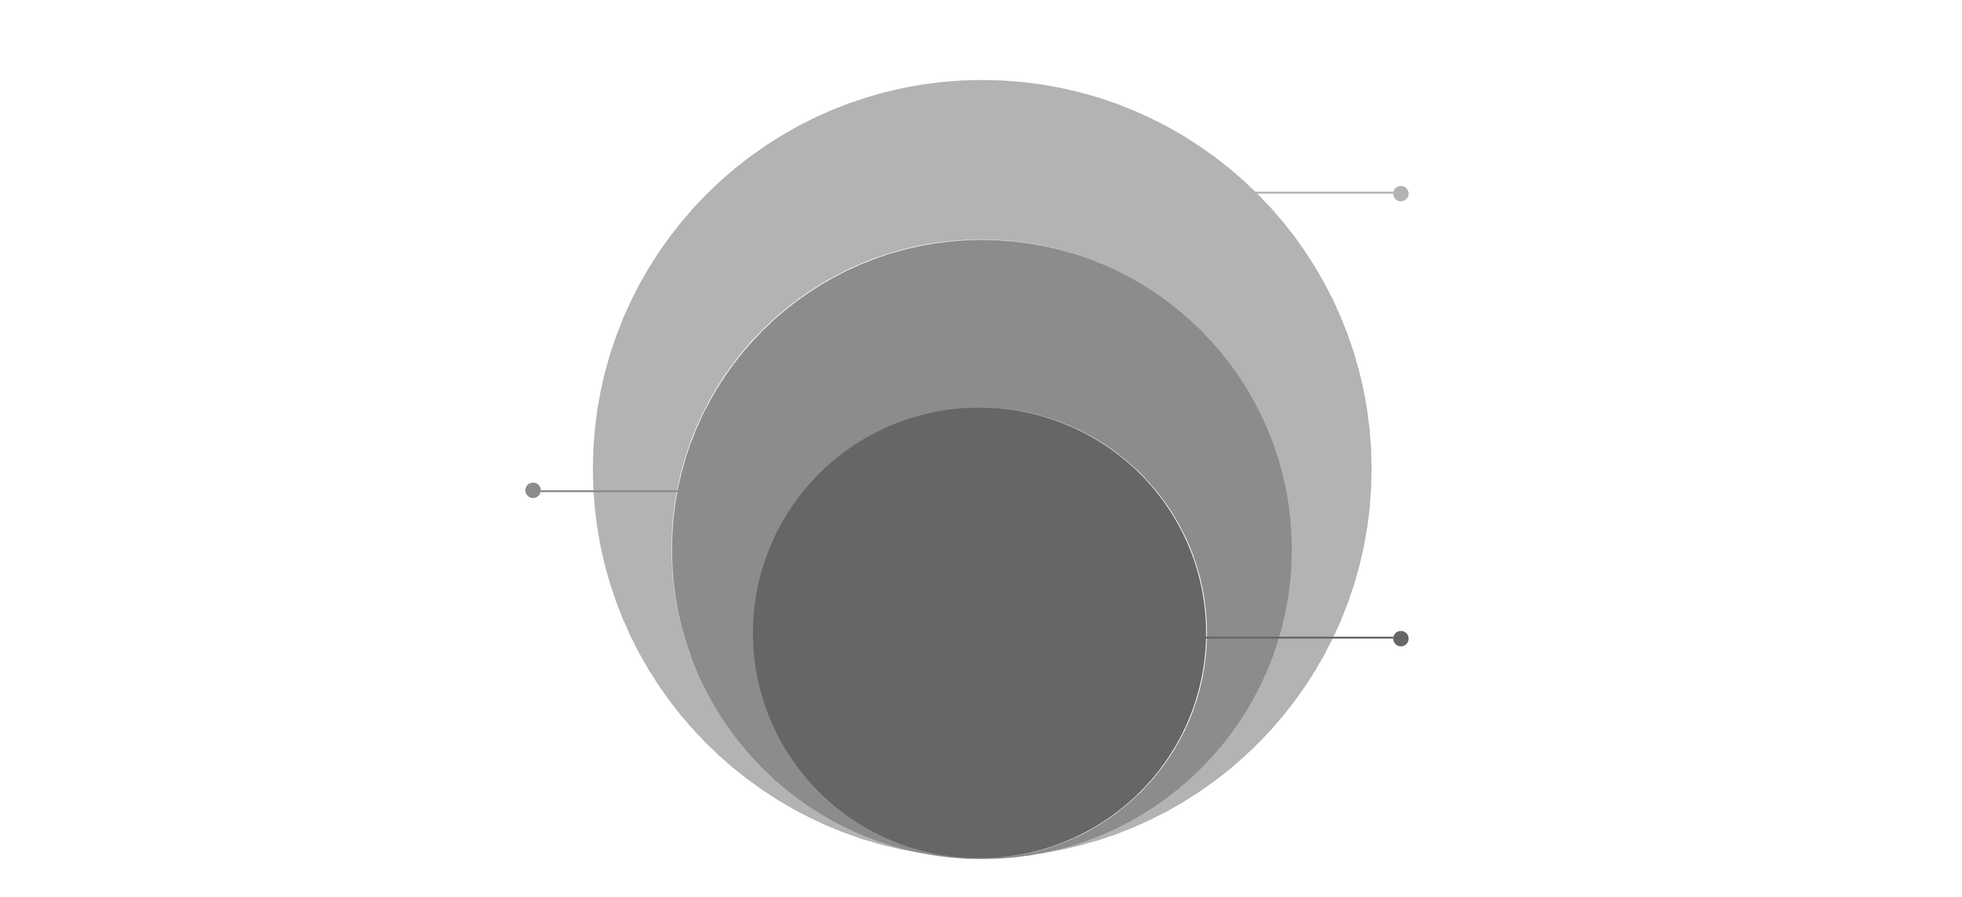

The CSS Box Model
Every HTML element is essentially a box, and understanding the CSS Box Model is crucial for proper layout and spacing. It defines how elements occupy space on a page.
Border & Margin
Border edge and outer spacing
Padding
Space between content and border
Content
Text, images inside the element
Content
Padding
The actual content of the element, such as text or images.
The space between the content and the border of the element. It's inside the border.
Border
Margin
A line that goes around the padding and content. It's visible and can have various styles.
The space outside the border, separating the element from other elements on the page.
Width & Height
Opacity
Dimensions of the content area. Can be set explicitly or be fluid.
Controls the transparency of the entire element (0 for fully transparent, 1 for fully opaque).

Slide 10
Practice Time: Building a Simple Card
Let's put our knowledge into practice by creating a simple "card" component using the CSS properties we've learned. This exercise will consolidate your understanding of text styling, backgrounds, and the box model.
HTML Structure:
<div class="card"> <h2>My Awesome Card</h2> <p>This is a sample card demonstrating CSS.</p> </div>
CSS Styles:
.card { background-color: #FFFFFF; /* White background */ padding: 20px; /* Inner spacing */ margin: 30px auto; /* Outer spacing (auto for centering) */ border: 1px solid #E0E0E0; /* Light grey border */ width: 300px; /* Fixed width */ text-align: center; font-family: 'Segoe UI', sans-serif; box-shadow: 2px 2px 8px rgba(0,0,0,0.1); /* Subtle shadow */ } .card h2 { color: #1D1F22; font-size: 24px; font-weight: bold; margin-bottom: 10px; } .card p { color: #555555; font-size: 16px; line-height: 1.5; }
Observe how the combination of text style, background, padding, margin, and border transforms a basic <div> into an elegant, well-defined card. Experiment with different values to see how each property influences the final look!

